Slide 1




Migratoor
Migrate to Scroll L2 with Zero Overhead. Empower Your Project with vLayer's Time Travel and Scroll’s L1 State Reading Features, Make It Multichain With Chainlink CCIP.

Slide 2

Problems we are solving
No Standard Migration Mechanism
L2 Migration Challenges
Lack of User Alignment
Many projects launched on Layer 1 (L1) aim to move to Layer 2 (L2) for improved user experience and additional features.
One approach is complete migration, abandoning multi-chain operations.
Migration currently requires projects to build their own solutions.
This creates a fragmented and non-seamless experience for users.
Users often lack incentives to migrate.
Instead, they may sell tokens on L1, disrupting the migration process.

Slide 3



Solution
— We have developed a universal trustless protocol that simplifies migration for any project, offering flexibility and ease of use.

Slide 4



Key Features
Flexible Rewards Options
Customizable Time Ranges
Snapshot-based migration: Seamless and precise.
Time-Averaged Balance migration: Ensures fair and balanced transitions.
Tailor the timing of snapshots to fit project-specific needs.
User Incentivization Strategies
Time-based rewards: Encourage users to act within specific timeframes.
Protocol loyalty bonuses: Reward users for long-term commitment.
Early migration incentives: Motivate early adopters with exclusive benefits.

Slide 5

How Did We Achieve This?

Slide 6
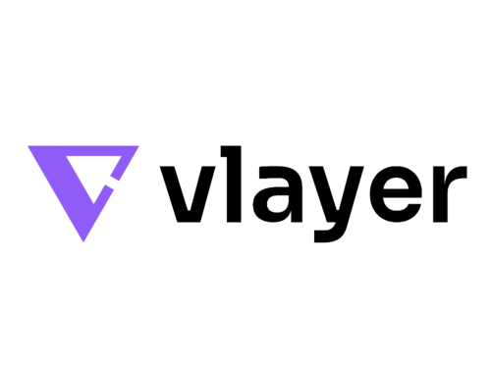



Cross-chain integration using CCIP
vLayer’s Time Travel Technology
Scroll’s Innovative L1SLOAD Precompile
Enables retrieval of historical data, particularly user balances.
Decentralized interoperability solution for migrated token exposure to the broad DeFi ecosystem
Provides direct access to L1 storage for verifying that users have locked tokens on L1.
Eliminates centralization risks (e.g., relayers) by leveraging: zk-Proof Soundness and Completeness: Secured through zkEVM.

Slide 7

Dive deeper
into solution

Slide 8


Project
User
Deploys L2-native token
Locks L1 tokens
Calls Migratooor deployer
(deploys migrator infrastructure with chosen parametrization)
Generates zk-Proof of average balance
Escrows tokens for users rewards in Migratooor
Uses Proof to Claim Tokens with Potential Bonuses on Scroll

Slide 9

Features
Community Goods Infrastructural Protocol
Seamless UX for protocol and users
Incentive mechanism
Secured protocol by
ZK proofs
Scroll Tech-stack advantages!
Out of the box inter-chain L2-native token thanks to CCIP integration

Slide 10

Roll-up centric roadmap

Slide 11

Sepolia L1
L1 Bridging
Contract
L2 Bridging
Contract
Sepolia Scroll
CCIP CCT
L1SLOAD ensures that the token has been locked on L1.
Migrated
ERC20 Token
community
User migrates token ERC20
fresh tokens are minted on Scroll
ERC20 Token
comunity
User creates bridge request
and locks amount of tokens
Rewards Token
Vlayer verifier
Implementation
Off-chain Vlayer computation of the average user's holding balances during the rewards eligibility period
* Migration Flow
* Rewards calculation and retrieval Flow

Slide 12

A little bit more about Rewards
Rewards can be distributed in the same migrated token, rebasing the total supply in favor of long-term holders.
Protocol owners should lock the rewards token into the bridge before starting the claiming period. The amount of rewards per reward-unit is calculated as:
TotalRewardsTokenLocked/TotalRewardsUnitsGenerated

Slide 13

Thank you!
See you on the winners stage

